Slide 1


Luca Iacovella
26 Feb. 2024

Slide 2

Outline
Executive Summary
Introduction
Methodology
Results
Conclusion
Appendix

Slide 3
Executive Summary
Used methodologies
Data collection
SpaceX API
Wikipedia webscraping
Data wrangling in Pandas
Exploratory Data Analysis (EDA)
with SQL
with visualization
Interactive Visual Analytics with Folium and Plotly Dash
Machine learning model building in Scikit-Learn
Results
Different graphs indicate correlation between launch properties and success rate
Decision tree predicts success well

Slide 4
Introduction
SpaceX wants to bring affordable space travel
Launches from different sites
Each launch has different properties
These properties might influence the success of a mission
Goal: predict mission success based on launch properties

Slide 5

Section 1

Slide 6
Methodology
Executive Summary
Data collection methodology:
By making API-calls to SpaceX’s API
By scraping the Wikipedia article on Falcon launches
Perform data wrangling
Extracted landing success status
Perform exploratory data analysis (EDA) using visualization and SQL
Perform interactive visual analytics using Folium and Plotly Dash
Perform predictive analysis using classification models
Trained and evaluated 4 different machine learning models

Slide 7
Data Collection
SpaceX API data:
Source: https://api.spacexdata.com/v4/
Collected using API-calls
Additional API-calls for more detailed information
Wikipedia article Falcon launches:
Source: https://en.wikipedia.org/wiki/List_of_Falcon_9_and_Falcon_Heavy_launches
Collected using BeautifulSoup4 webscraping
Manual cleaning was then performed

Slide 8
Data Collection – SpaceX API
GitHub URL
GET /launches/past
For each rocket GET /rockets/rocket
For each launchpad
GET /launchpads/launchpad
For each payload
GET /payloads/payload
API-call to get historic overview of rocket launches
API-call to get the rocket name
API-call to get the geolocation of the launchpad
API-call to get the payload (in kg) and orbit

Slide 9
Data Collection - Scraping
GitHub URL
GET Falcon launches Wikipedia article
Extract and clean columns
Parse table records into DataFrame
Save result as CSV
Get the Wikipedia article and parse it using BeautifulSoup
Clean columns (by removing unnecessary HTML) and remove unused columns
Iterate over soup object, clean the values and insert into Pandas DataFrame
Store the resulting DataFrame as CSV for later use

Slide 10
Data Wrangling
Calculated amount of launches per site
Calculated occurrence of each orbit
Calculated amount of mission outcomes per type
Calculated success rate across all missions
GitHub URL

Slide 11
EDA with Data Visualization
The visaluation EDA mainly consisted finding correlation with success rates
Per launch site, influence of flight number on success rate
Per launch site, influence of payload mass on success rate
Influence of orbit type on success rate
Per orbit type, influence of flight number on success rate
Per orbit type, influence of payload mass on success rate
Influence of launch year on success rate
GitHub URL

Slide 12
EDA with SQL
SQL was used to query the launch data with regards to
Launch sites
Payload mass
Booster versions
Mission outcomes
GitHub URL

Slide 13
Build an Interactive Map with Folium
Folium was used to visualize the launch sites on a map
The interactive map included the amount of launches per location
The proximity of the following was studies:
Coasts
Railways
Highways
Cities
GitHub URL

Slide 14
Build a Dashboard with Plotly Dash
Study success rate of
Launch sites
Payload mass
Booster version category
Launch site success with Pie chart for
Payload mass and booster version category with scatter plot to distinguish good and bad ranges
GitHub URL

Slide 15
Predictive Analysis (Classification)
One-hot encoded features
Separate test set from training set
Standardize data
Fit training data to different models
Evaluate models using test data
GitHub URL

Slide 16

Section 2

Slide 17
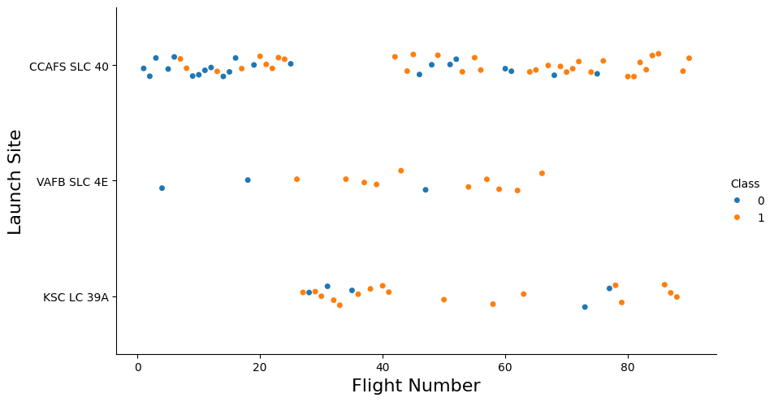
Flight Number vs. Launch Site
Orange dots indicate successful launches
A higher flight number correlates with success rate
This trend is true for all launch sites

Slide 18
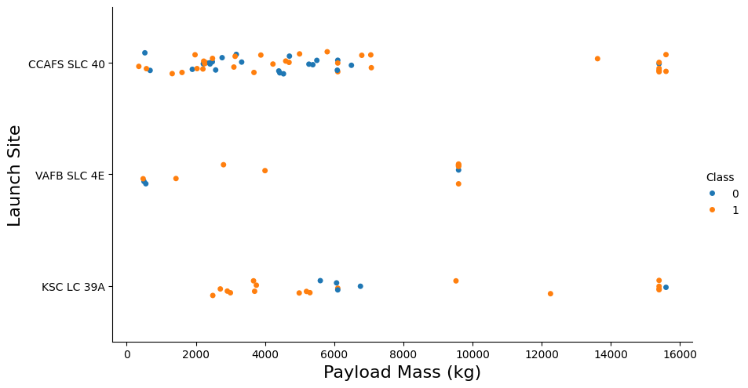
Payload vs. Launch Site
VAFB SLC launch site seems to have a max payload of 10,000 kg
Higher payload mass seems to correlate with higher success rate, for all launch sites
This could be due to low payload mass implying early test launches

Slide 19
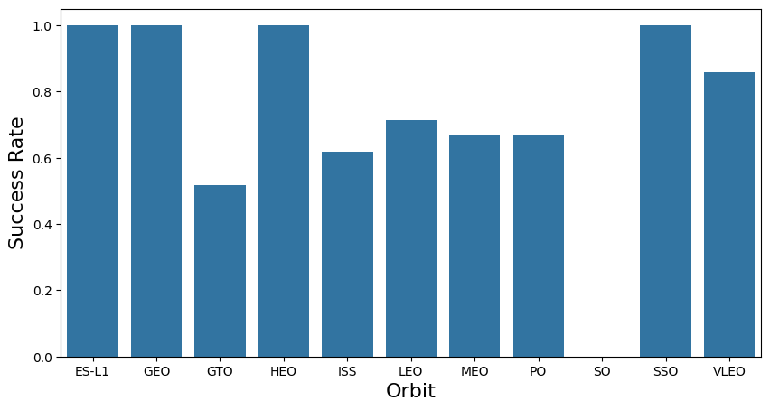
Success Rate vs. Orbit Type
SO orbit has not been achieved
ES-L1, GEO, HEO, SSO always succeeded
The other orbit success rates range from 50% to 90%

Slide 20
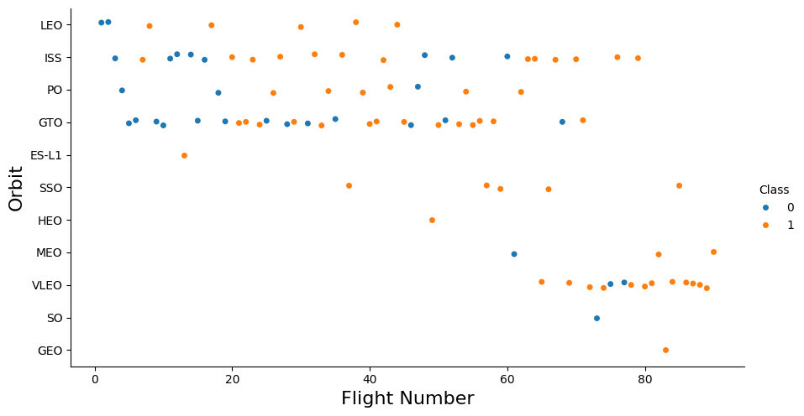
Flight Number vs. Orbit Type
Success rate and flight number relation depends on orbit, e.g.:
LEO orbit success relates to higher flight number
GTO orbit success rate and flight number seem unrelated

Slide 21
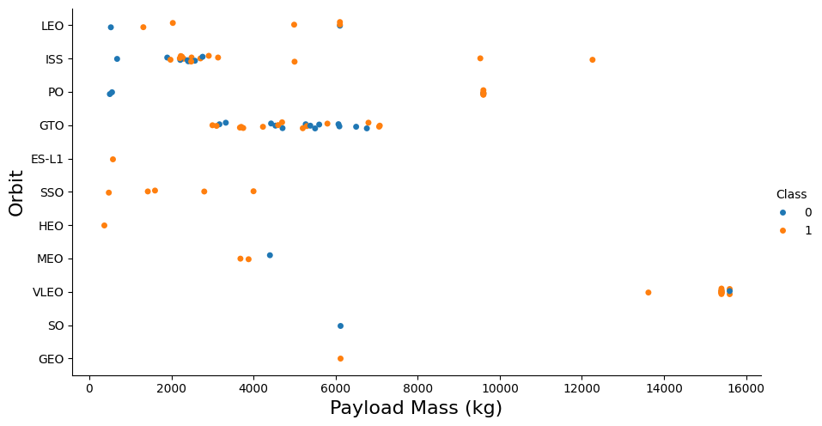
Payload vs. Orbit Type
Success rate and payload relation dependent on orbit too
No relation for GTO
Relation for LEO, ISS, PO

Slide 22
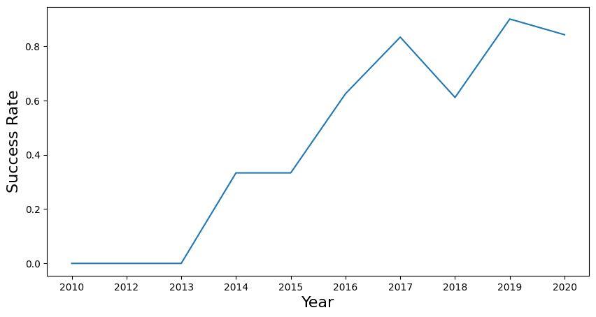
Success rate yearly trend
As the years pass, success rate increases
General trend, not perfect

Slide 23
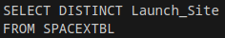
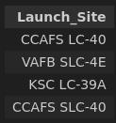
All Launch Site Names
Use the DISTINCT keyword to get all unique Launch_Sites

Slide 24
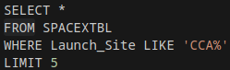
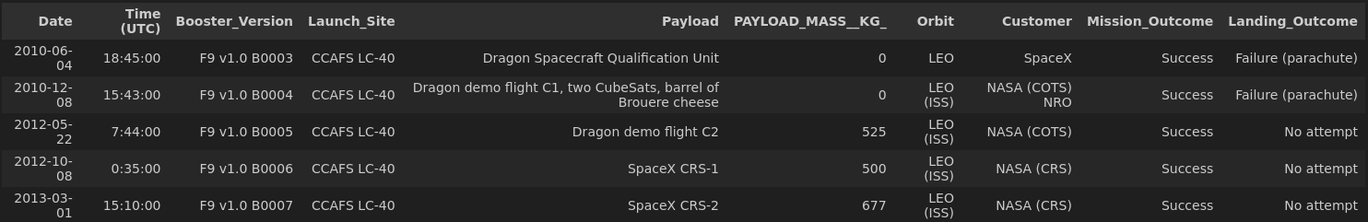
Launch Site Names Begin with 'CCA'
Used the LIKE keyword to match pattern
Used % operator to match multiple characters
Used LIMIT keyword to keep 5 records

Slide 25
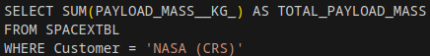
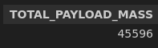
Total Payload Mass
Used SUM aggregator function to add all payload mass values

Slide 26
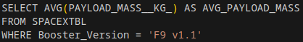
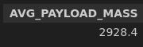
Average Payload Mass by F9 v1.1
Used AVG aggregator function to get the average payload mass value

Slide 27
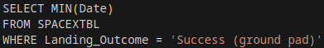

First Successful Ground Landing Date
Used the MIN aggregator function to get the lowest date value

Slide 28
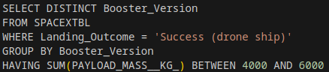
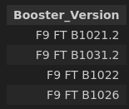
Successful Drone Ship Landing with Payload between 4000 and 6000
Grouped by Booster_Version
Filtered each group using SUM aggregator
Used BETWEEN keyword to define necessary range

Slide 29
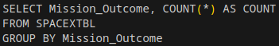
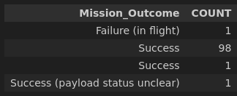
Total Number of Successful and Failure Mission Outcomes
Grouped by Mission_Outcome
Aggregated using COUNT function to get the amount per outcome

Slide 30
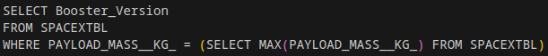
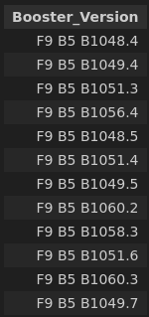
Boosters Carried Maximum Payload
Used sub-query to get maximum payload mass
Filtered Booster_Versions that have this maximum payload mass

Slide 31
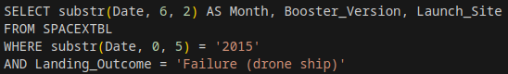
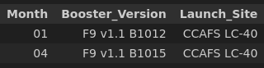
2015 Launch Records
Used substr function to get the Month and Year position from the Date string

Slide 32
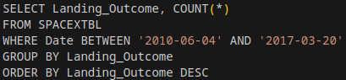
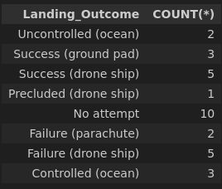
Rank Landing Outcomes Between 2010-06-04 and 2017-03-20
Used lexicographical property of Date format to filter based on Date range
Ordered by descending Landing_Outcome label

Slide 33

Section 3

Slide 34
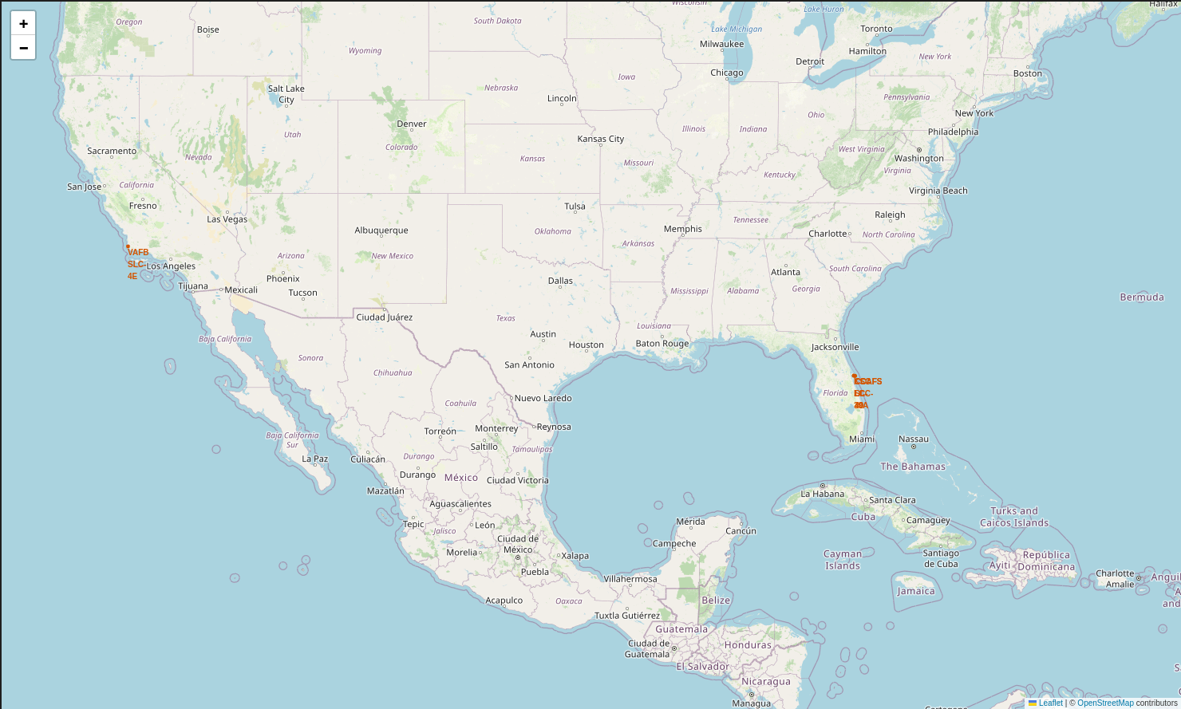
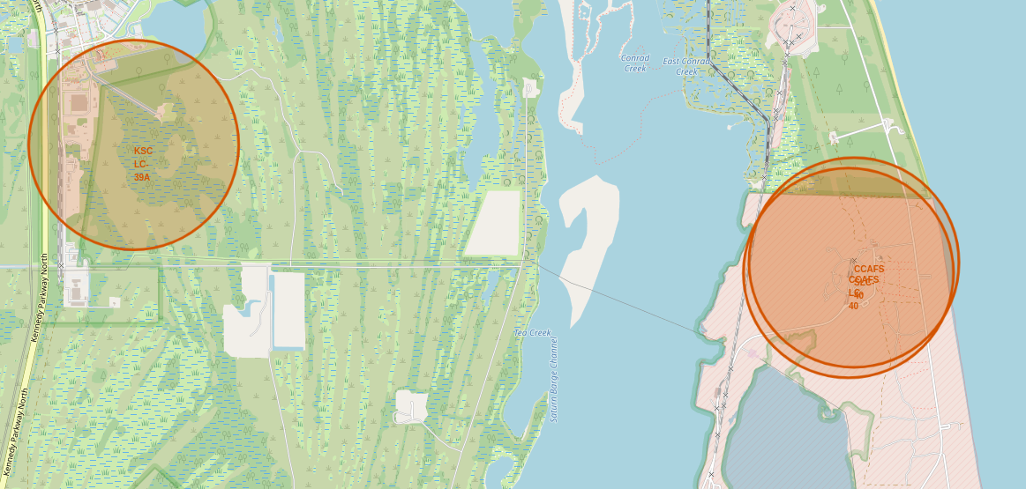
Launch Sites on Map
Launch sites on map
Highlighted with circle
Labelled by name

Slide 35
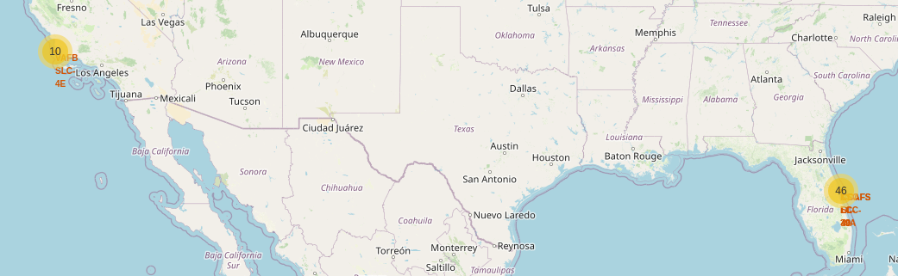
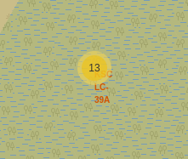
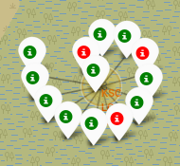
Launch Outcomes per Launch Site
Launch sites have a number in yellow circle for the total amount of launches
When clicked, it reveals the successful (green) and failed (red) launches

Slide 36
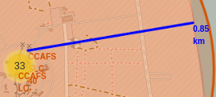
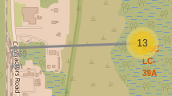
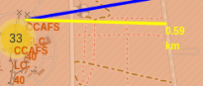
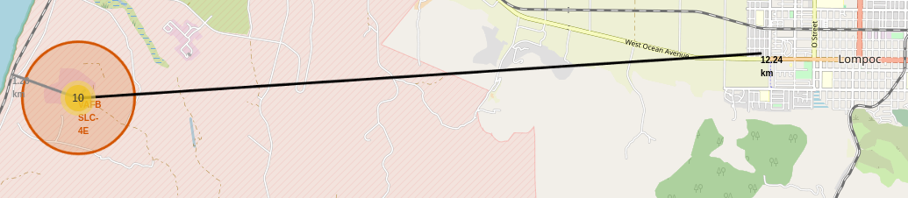
Launch Site Proximity
Launch sites are close to coasts, railways and highways
Close to coast might be for safety (in case of failure) if the launches are directed towards the coast
Proximity might be for logistic reasons: ships, trains and trucks might be used to deliver rocket parts
Launch sites seem to be at least 10 km from cities with residential areas, likely for safety

Slide 37

Section 4

Slide 38
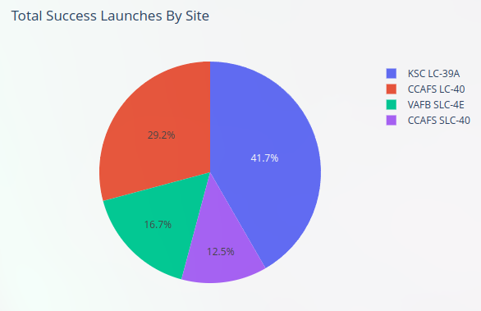
Launch Site Success Rate
Pie chart representing number of successful launches per launch site
KSC LC-39A has the most successful launches, CCAFS SLC-40 the least

Slide 39
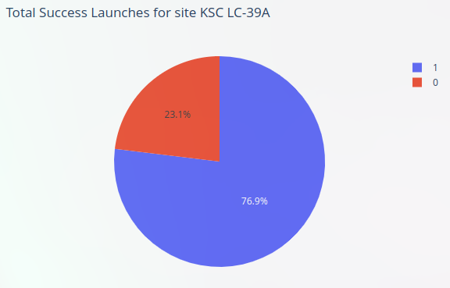
KSC LC-39A Success Rate
Pie chart representing the successful launches and failed launches of KSC LC-39A
This launch site has the highest success rate (also highest total successful launches)

Slide 40
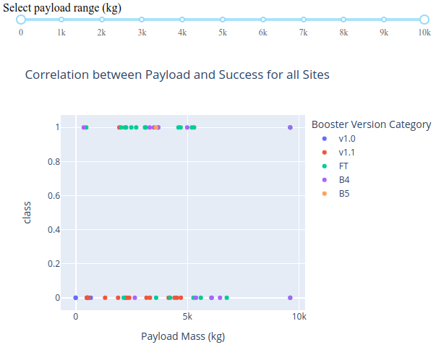
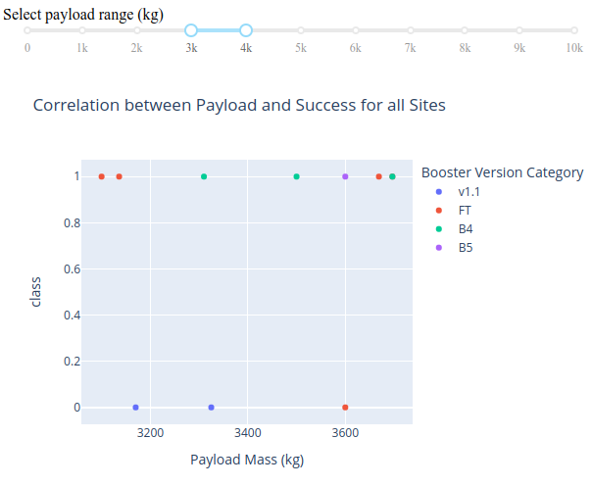
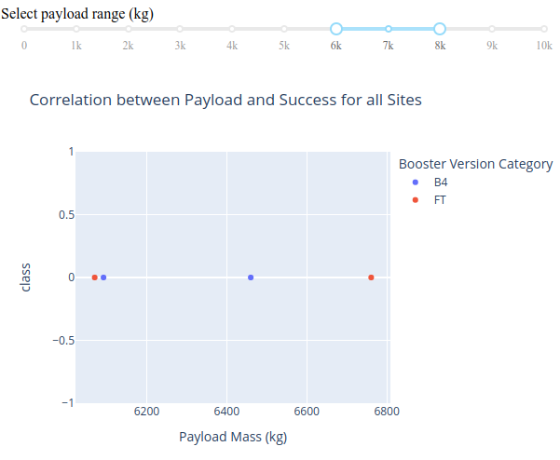
Payload Mass and Booster Version Cat.
Each dot represents a launch, colored by the booster version category
Y-axis represents if the launch was a success
X-axis represents the payload mass
The F9 FT booster has the highest success rate
The highest success rate is found between 3k-4k kg and the lowest between 6k-8k kg

Slide 41

Section 5

Slide 42
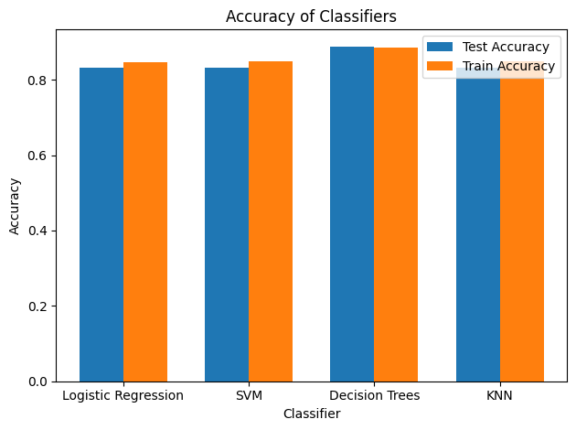
Classification Accuracy
Classification of landing outcome
One-hot encoding of features
Split data in train and test set
Trained and evaluated using 4 different types of models
Logistic regression
SVM
Decision tree
kNN

Slide 43
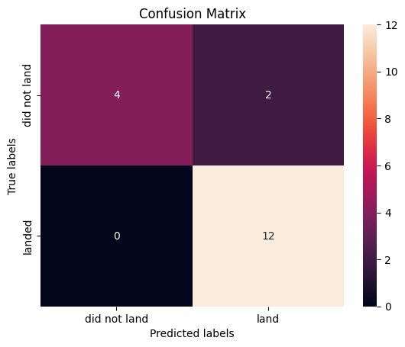
Confusion Matrix
Best model: Decision tree
Acceptable performance: 89%
Good recall
Precision needs improvement
Model does not predict well in case of non-landing
Too many false positives

Slide 44

Conclusions
We used geodata to find out more properties of the launch sites
Orbit type, flight number, launch year, payload mass seem to correlate with success rate
Some launch sites had better success rates than others
The decision tree model had the highest classification accuracy

Slide 45


